Slide 1

BATCH IN 2019

Slide 2
Safe Harbor Statement
The following is intended to outline the general direction of Pivotal's offerings. It is intended for
information purposes only and may not be incorporated into any contract. Any information
regarding pre-release of Pivotal offerings, future updates or other planned modifications is
subject to ongoing evaluation by Pivotal and is subject to change. This information is provided
without warranty or any kind, express or implied, and is not a commitment to deliver any
material, code, or functionality, and should not be relied upon in making purchasing decisions
regarding Pivotal's offerings. These purchasing decisions should only be based on features
currently available. The development, release, and timing of any features or functionality
described for Pivotal's offerings in this presentation remain at the sole discretion of Pivotal.
Pivotal has no obligation to update forward looking information in this presentation.

Slide 3

2019!

Slide 4

ANY REPLICANTS?

Slide 5


HOVERBOARDS OR FLYING CARS?

Slide 6
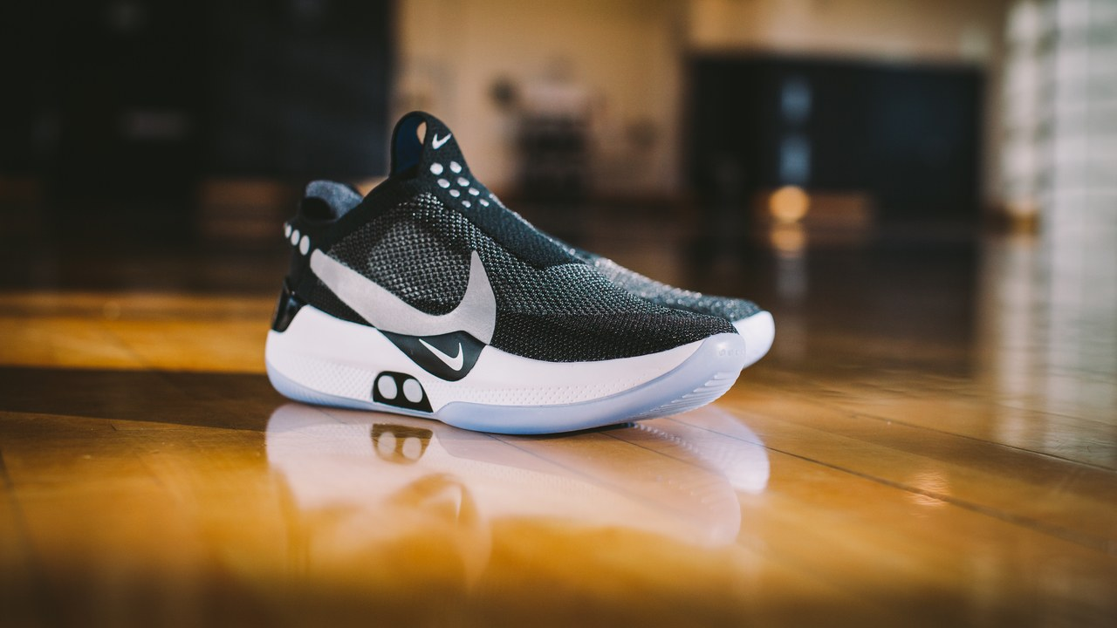
SELF LACING SHOES!

Slide 7
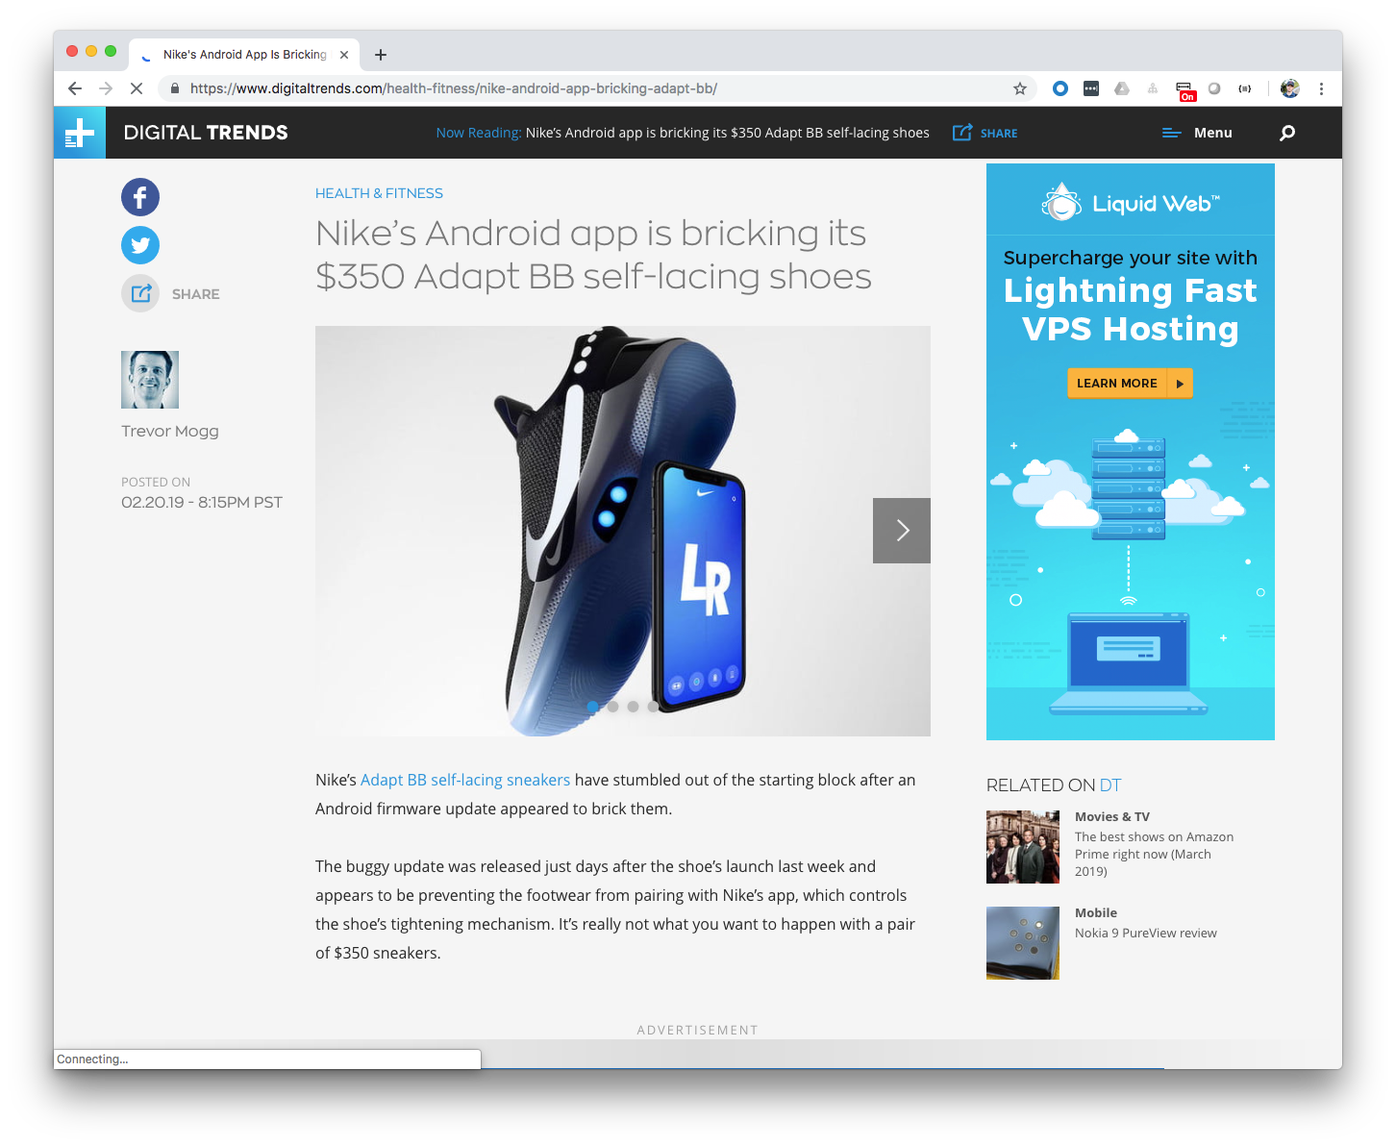

Slide 8

ALL THESE AMAZING THINGS
THE FUTURE HAS BROUGHT US…

Slide 9


Slide 10
고맙습니다!
شكرا لك.
Hvala vam!
Merci!
¡Gracias!
Dziękuję!
Благодарю!
धन्यवाद।
THANK YOU!
Danke!
Děkuju!
Grazie!
Sağol!
Obrigado!
Благодаря!
谢谢!

Slide 11


MICHAEL MINELLA
Lead – Spring Batch &
Spring Cloud Task
JSR-352 - Expert Group Member
Author – Pro Spring Batch
The D G to Spring Batch
Speaker - JavaOne Rockstar
Java Champion
Podcast - OffHeap Curmudgeon
Twitter - @michaelminella or
@OffHeap

Slide 12

COMING THIS SUMMER!
https://www.apress.com/us/book/9781484237236

Slide 13

SLIDES AND CODE
ARE ON GITHUB
https://github.com/mminella/Batch-In-2019
Notes:
S1P 2018 branch was used in the presentation at Spring One Platform 2018

Slide 14

Notes:
Please ask questions when you have them

Slide 15


LAY OF THE LAND

Slide 16

SPRING FRAMEWORK

Slide 17
SPRING BATCH

Slide 18

SPRING CLOUD DATA FLOW

Slide 19

MICROMETER

Slide 20

PROMETHEUS

Slide 21

GRAFANA

Slide 22
¯\_(ツ)_/¯

Slide 23

DAY IN THE LIFE OF
A BATCH DEVELOPER

Slide 24

GET OUR COFFEE

Slide 25

CHECK THE STATUS
OF THE EXISTING JOBS

Slide 26

ADD A NEW FEATURE

Slide 27

GO TO
PRODUCTION!

Slide 28

CHECK THE STATUS
OF THE EXISTING JOBS

Slide 29



Spring Batch/Spring Cloud Task
Push Gateway
Prometheus
Grafana
Spring Cloud Data Flow

Slide 30

ADD A NEW FEATURE

Slide 31
Step1
Step2
ItemReader
ItemProcessor
Tasklet
ItemWriter

Slide 32

GO TO
PRODUCTION!

Slide 33
Github
CircleCI
Spring Cloud Data Flow
Maven Repository

Slide 34

LOOKING AHEAD

Slide 35
SPRING BATCH 4.1.1.RELEASE

Slide 36
SPRING BATCH 4.2.0.M1

Slide 37
SPRING BATCH 4.2.0.RELEASE

Slide 38

PERFORMANCE

Slide 39
METRICS VIA
MICROMETER

Slide 40
SPRING CLOUD DATA FLOW 2.0!

Slide 41
ANALYTICS VIA
MICROMETER
Notes:
Apps have support for Prometheus, InfluxDB, and Data Dog

Slide 42
REVAMPED METRICS
VIA MICROMETER

Slide 43

SECURITY
IMPROVEMENTS

Slide 44

DASHBOARD
IMPROVEMENTS

Slide 45
DATABASE MIGRATION
SUPPORT

Slide 46

MULTIFOUNDATION
SUPPORT FOR TASKS

Slide 47
Notes:
Please ask questions when you have them

